Slide 1
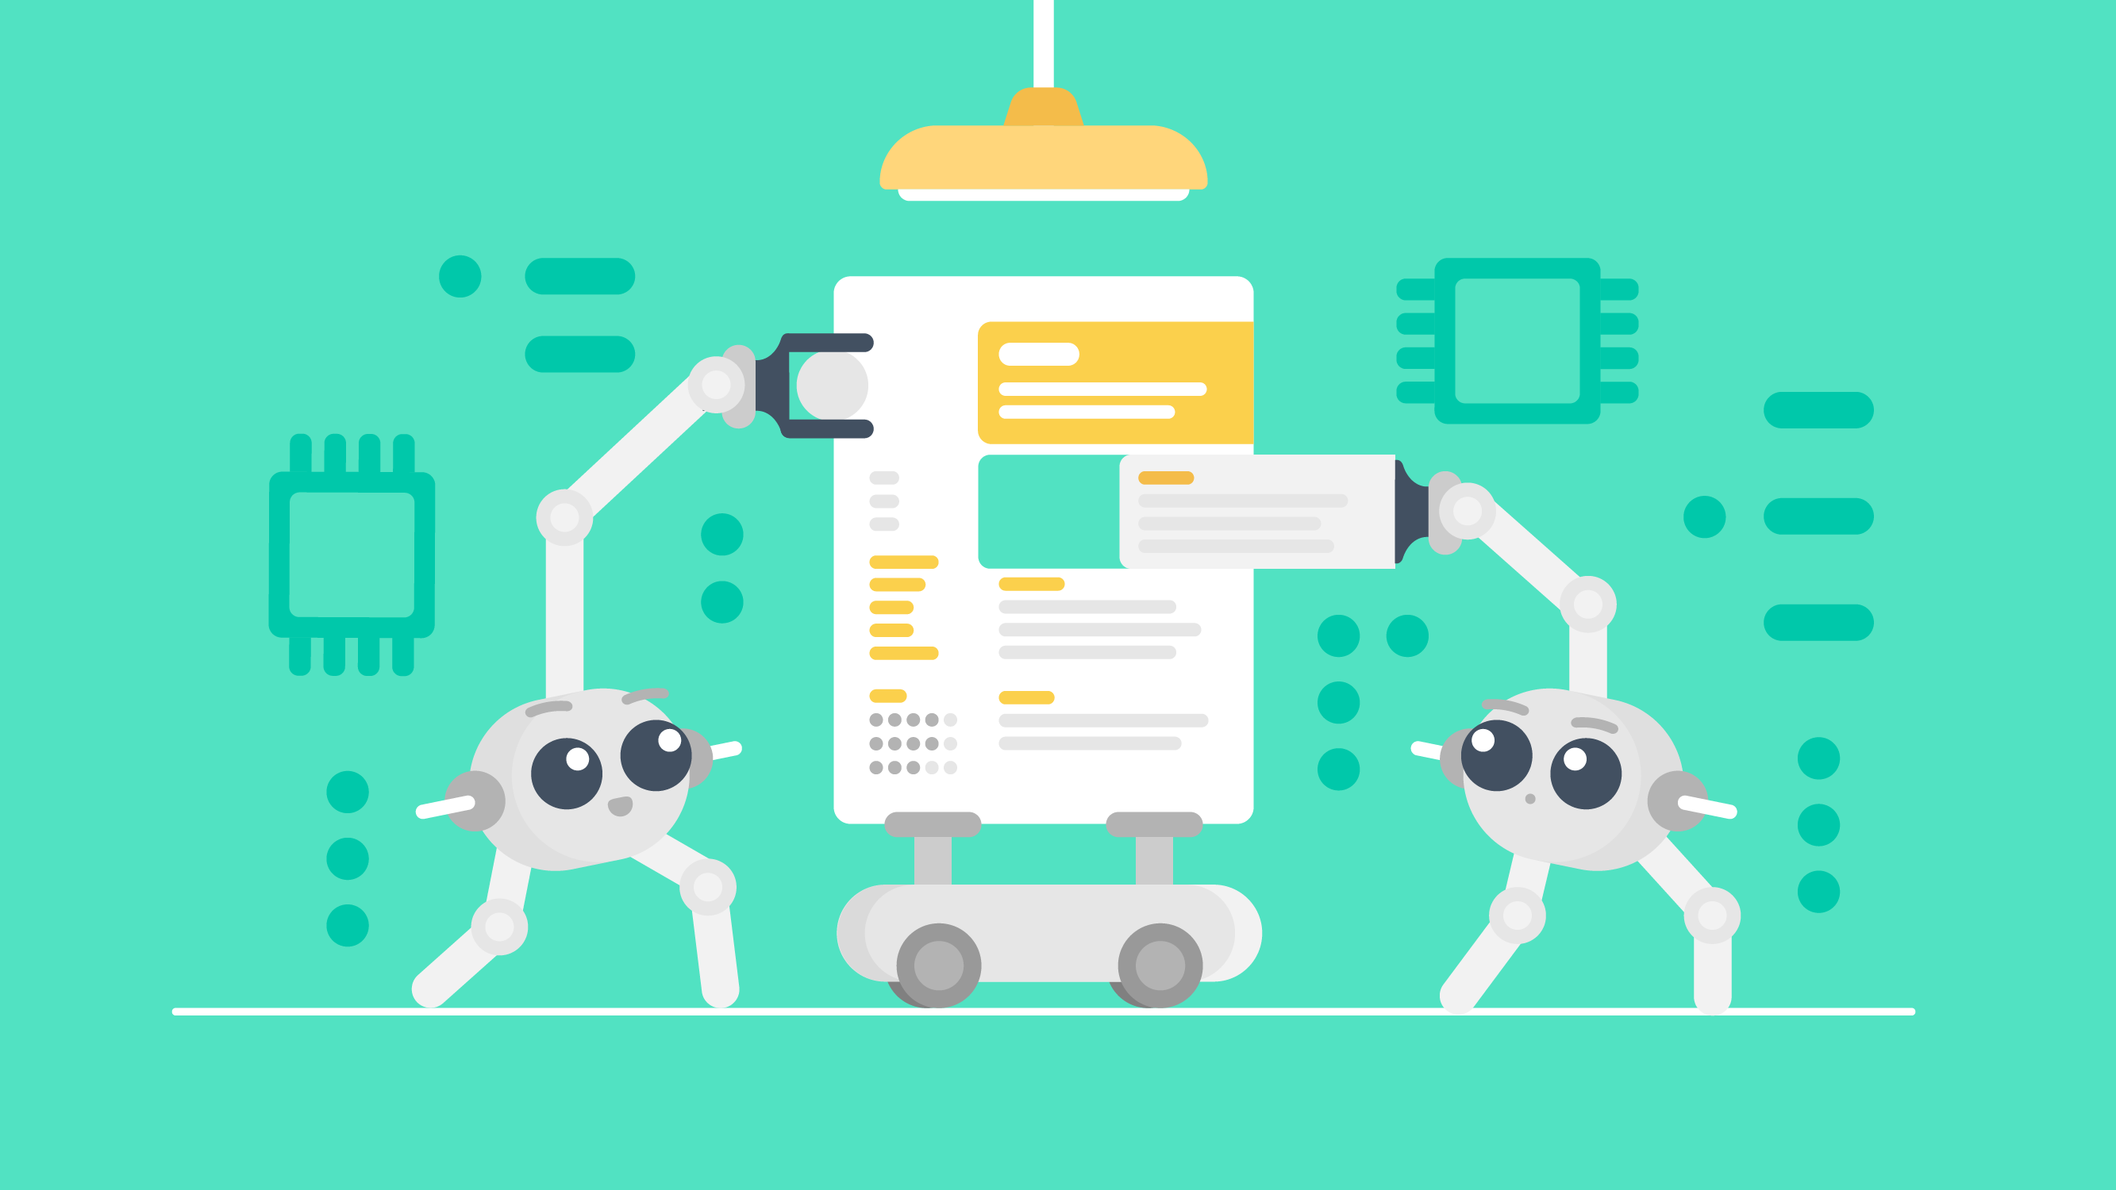
AI Workshop
Building Resumes Using AI
From Good to Great Enhancing your CV with AI Tools

Slide 2

Agenda
Introduction to AI
Importance of a well-crafted resume.
AI in modern resume building.
Why Use AI for Resume Building?
Understanding AI Tools for Resume Building
Live Demo: Creating a Resume
Common Mistakes and How AI Helps Avoid Them
Q&A Session

Slide 3

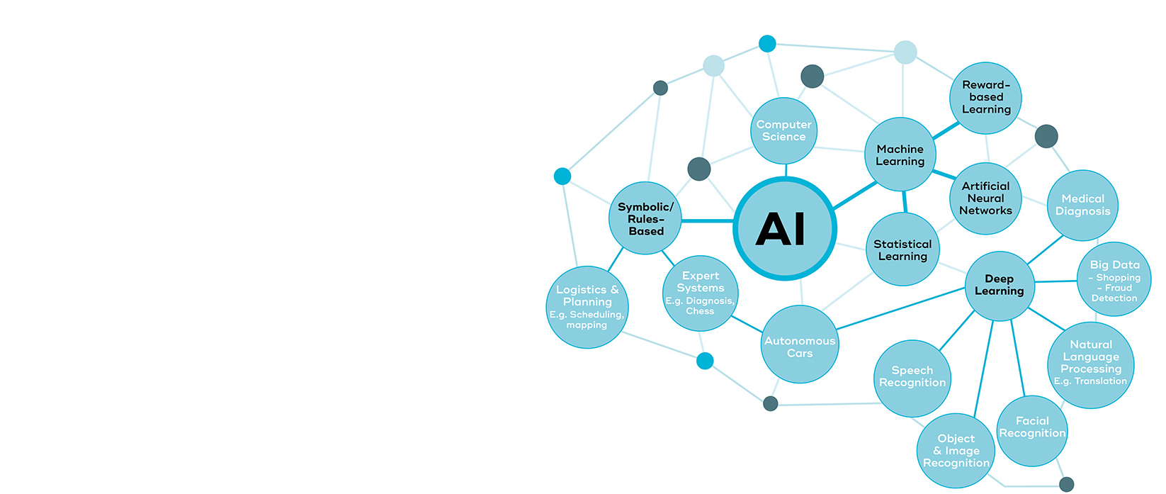
What is AI?
Artificial Intelligence (AI) refers to systems or machines that simulate human intelligence to perform tasks.

Slide 4

Example for What is AI?
Scenario: You are applying for a Data Analyst role.
How AI Helps: AI analyzes the job description, identifies key skills such as "SQL," "data visualization," and "Python," and ensures your resume highlights these skills by suggesting tailored bullet points and phrasing.

Slide 5

Importance of a Well-Crafted resume:
A well-crafted resume is essential for showcasing your skills, experience, and qualifications effectively to potential employers.
First Impression: Your resume is often the first point of contact with a potential employer. A well-organized and professional resume creates a positive impression.
Showcases Relevant Skills: A tailored resume highlights the skills and experiences relevant to the job, making it easier for employers to see why you're a good fit.
Professional Branding: A resume reflects your professionalism, attention to detail, and ability to communicate effectively.
Highlights Achievements: Employers value results. Including quantifiable achievements makes your resume stand out.

Slide 6

AI in Modern Resume Building:
Personalization:
  AI tailors resumes to job descriptions by analyzing keywords.
  Example: Suggests adding "Project Management" for a PM role.
ATS (Application Tracking Systems) Optimization: Formats resumes to pass Applicant Tracking Systems (ATS).
Time-Saving: Automates grammar, formatting, and structure.
Error-Free Documents: Highlights grammar and consistency issues.

Slide 7

Why Use AI for Resume Building? Harnessing Technology for Career Success
Customization for Job Fit: AI tailors resumes to job descriptions using keyword analysis.
  Example: Highlights matching skills like "Data Analysis" for a Data Scientist role.
Time Efficiency: Automates formatting, grammar corrections, and layout design.
  Example: Creates polished resumes in minutes instead of hours.
ATS Optimization: Ensures resumes pass Applicant Tracking Systems by structuring content properly.
Improves Quality and Accuracy: Detects grammar errors, redundancies, and inconsistent formatting.

Slide 8
Understanding AI Tools for Resume Building :
AI Resume-Building Tools are advanced applications powered by Artificial Intelligence that assist individuals in creating, optimizing, and formatting professional resumes.
These tools leverage machine learning, natural language processing (NLP), and data-driven insights to make the resume-building process efficient and tailored to specific job requirements.
These tools Automates resume writing to save time, ensure quality, and improve relevance

Slide 9


Popular Free AI Resume Tools:
Zety:
  Features: Offers customizable templates, real-time content suggestions, and tips for crafting a professional resume.
  Website: https://builder.zety.com/
Resumake:
  Features: A simple, free online resume builder with customizable templates and no signup required. Canva: Offers visually appealing, AI-enhanced templates.
  Website: https://resumake.io/
Canva:
  Features: Offers AI-enhanced design templates that are modern and visually appealing. Provides layout suggestions and easy drag-and-drop functionality.
  Website: https://www.canva.com/

Slide 10
4. Novoresume:
  Features: Offers AI-driven content optimization and ATS-friendly templates. The free plan includes a one-page resume.
  Website: https://novoresume.com/
5. Standard Resume:
  Features: A free resume builder that focuses on simplicity and ATS compatibility. Allows you to quickly create a resume from your LinkedIn profile or by manually entering data.
  Website: https://standardresume.co/
6. Resume.com:
  Features: Provides step-by-step guidance to build resumes with predefined sections. Includes several pre-made templates.
  Website: https://www.resume.com/

Slide 11



Live Demo Creating a Resume

Slide 12
Common Mistakes:
Spelling and Grammar Errors:
  Mistake: Typos and poor grammar reduce professionalism.
  AI Solution: AI-powered tools automatically detect and correct errors in spelling, grammar, and punctuation.
  Example: Grammarly integration for real-time corrections.
2. Lack of ATS Optimization:
  Mistake: Resumes not formatted to pass Applicant Tracking Systems (ATS).
  AI Solution: AI tools analyze job descriptions and ensure that resumes are optimized with relevant keywords and proper formatting.
  Example: Rezi optimizes resumes for ATS compatibility.
3. Overuse of Generic Content:
  Mistake: Using generic skills and experiences that don't stand out.
  AI Solution: AI suggests personalized skills and achievements tailored to the specific job.
  Example: AI analyzes job listings and matches your resume with industry-specific skills.

Slide 13


Slide 14


